Slide 1
Running Holiday Giving Campaigns with Skilled Volunteer Support
Taproot Foundation | August 2023

Slide 2
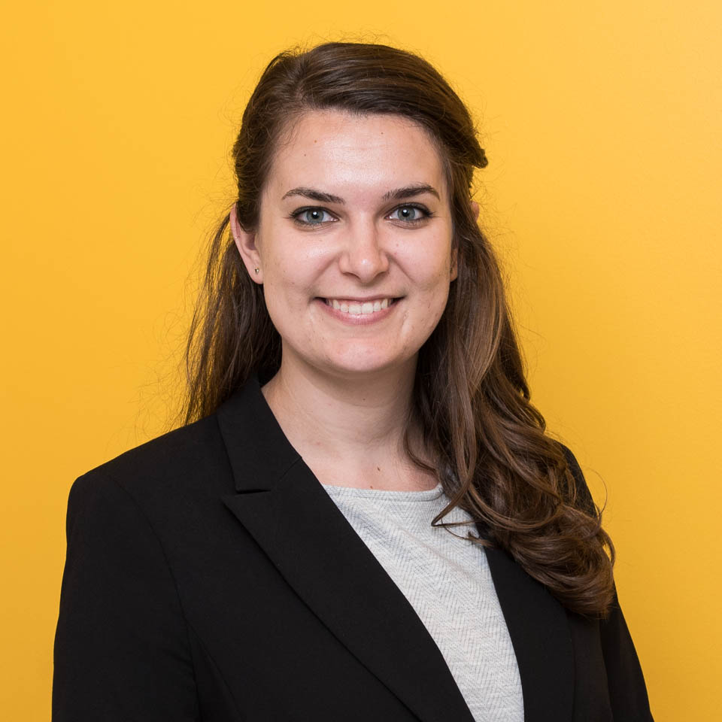
Meet The Presenter
Kimberly Swartz (she/her)
Senior Director, Community Engagement
Notes:
Introduce yourself and your role. Invite attendees to introduce themselves in the chat. Talk about your marketing background and how you regularly consult with early stage nonprofits on their marketing and business development challenges.
Logistics notes: this is in webinar format, attendees will be muted throughout. Please use the chat box to communicate with us. Sameena and Megan are covering the chat box and will answer questions throughout, or share with me for Q&A at the end of the event. This webinar is being recorded, that recording will be shared with all registrants by tomorrow.
During today’s event, we’ll be covering:​
Taproot introduction and overview of the services we provide through connections with our skilled volunteers
Marketing channels that you could leverage for your holiday giving campaigns
How volunteer support can help you create infrastructure, develop strategies, or even execute fundraising campaign elements through each one of those marketing channels
You will leave with OODLES of recommendations for tactics to use during your holiday giving campaign, and more importantly, loads of ideas for volunteer support that you can request RIGHT NOW through Taproot’s free programs
Q&A​

Slide 3
Meet Taproot
Taproot empowers mission-driven organizations by mobilizing skilled volunteers to advance resource equity.
Notes:
As you may know, Taproot is a nonprofit that exists to support our fellow nonprofits. Taproot was founded as a nonprofit in 2001 with the knowledge that there is a massive resource gap present in the social sector. Organizations who may very well have the solutions to our world’s most pressing social challenges simply do not have the financial means or staff capacity to carry out their missions to their fullest extent. Taproot is democratizing access to resources for nonprofits regardless of mission area, budget size, or years they’ve been in operations.
​

Slide 4
Taproot for
Nonprofit Organizations
22+
On-Demand
Issue Areas Served
Consultations and Projects Available
$300 million
Pro Bono Services Delivered
44
63%
Pro Bono Matches Weekly
Nonprofit Partners with
< 5 FTE
Notes:
[Kim]
Taproot is here to get nonprofits the business support they need, for free. Since the early 2000’s, Taproot has partnered with over 10,000 social change organizations and 24,000 volunteers – totaling $300 million in donated professional services.
We forge hundreds of pro bono connections every week through Taproot Plus – our free-to-use volunteer-nonprofit match-making platform. In addition to our community-led programming through Taproot Plus, our nonprofit has partnered with over 100 Fortune 500 companies through our Advisory Services practice – bringing talented corporate employee talent directly to nonprofits across Taproot’s network. Through the Taproot Plus platform, we’ve lowered all barriers to entry for organizations just starting out or looking to grow. In fact, many of our most active program participants are organizations who were founded under 5 years ago or who are completely volunteer-led. I’ve been emailing back and forth with many of you leading up to this webinar and know that this was a question for many of you so I wanted to address it head on – yes, start up and early-stage nonprofits are able to leverage Taproot pro bono resources and our staff is knowledgeable about your unique needs.

Slide 5
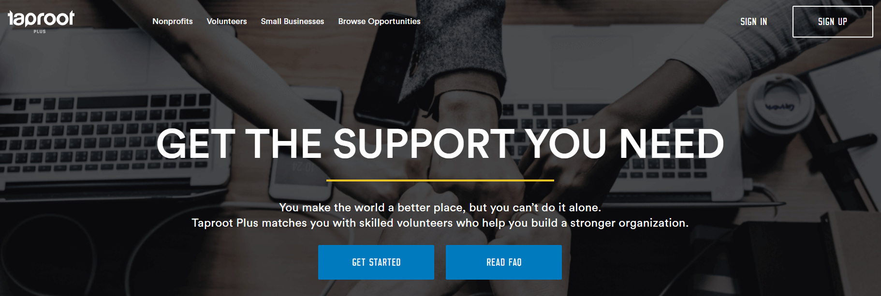
www.taprootplus.org
Join the Taproot Community
Free of cost, unlimited accounts for your staff or board
On-demand consultations and multi-week projects, access to Taproot’s full suite of corporate and grant-maker-led programming
Access to nonprofit coaching, networking, and pro bono readiness resources from the national leader in skills-based volunteerism
Notes:
Here you’ll find information about how to join the Taproot community. Our free, online nonprofit-volunteer match-making platform, Taproot Plus, is the front-door to accessing services through our nonprofit. Megan will also post the link in a banner at the top of the screen. As I mentioned, it’s free to have an account, request services, and leverage Taproot’s resources. We have a virtual community of over 150,000 volunteers from the worlds of IT & tech, business strategy, HR & leadership development, marketing & communications, software development, design & creative, operations & analytics, and more.
I’m sharing this program participation info with you right up top because if you hear about a volunteer project during the course of this webinar that your organization needs, I want you to immediately be able to sign up and request that support. Like I said, Megan and Sameena are in the chat right now ready to answer any questions. I won’t be offended at all if you pull up TaprootPlus.org in another tab and start drafting a volunteer request while I’m talking.
You and your nonprofit are able to submit on-demand requests for volunteer support through one-hour consultation calls with subject matter experts (we call these Sessions) and multi-week, in-depth projects where a volunteer works with you to create a specific deliverable. Keep these two pro bono options in mind because I’m going to reference them when I chat about fundraising campaign elements that volunteers can support with!

Slide 6
Skilled Volunteer Support for Your Holiday Giving Campaign

Slide 7
Holiday Giving Promotional Channels
Social Media
Content
Email
Public Relations
Notes:
I want to start by covering the marketing channels that your nonprofit is likely going to be utilizing as part of your holiday giving campaigns. They are likely going to include social media, content, email marketing, and public relations. Please shout out any other promotional channels you’ll be using in your holiday campaign and I’ll try to pepper in some recommendations for those channels as well!
Social media: this is going to be an especially important channel for you if you are focusing on individual giving. However, social media is also a key way to establish a high-quality, impact-first brand presence for current and potential funders. They will check out your feeds when considering your proposals. It’s a place for you to humanize your brand – generally social messaging is more casual in tone and focuses on storytelling. From my experience as a nonprofit social media strategist in former roles, my top tip here is to make sure that you have a well-balanced diet of social content in the lead-up to and throughout your holiday giving campaign. For every donation request you publish, make sure you’re sharing impact stats, stories of who your services are impacting, staff & board features, etc. I do not wat to donate to your social fundraiser unless you have consistently been on my feed, educating me on the issue you’re solving and the solutions your org employs.
Content marketing: a super broad term that really refers to the development and distribution of your organization’s story and viewpoint, especially in the online space. When we think about content as a promotional channel for fundraising, we’re thinking about how your website and the content on the site is using key words to maximize search engine optimization, we’re thinking about the stories, research, resources, and events your organization is creating and sharing with the community through email, social, webinars, and more. Your content marketing strategy will help you always have fresh, relevant materials to share with your newsletter lists, social audiences, potential funders, etc.
Email marketing: Let’s talk email marketing. In an extensive volunteerism research effort I led for Taproot last year, one of the most conclusive takeaways is that email is THE way people want to be notified about opportunities to support nonprofits. 91% of our respondents included this channel as their top option. When you think about how to leverage email for your holiday giving campaign, I would recommend not just thinking of it as a collection of one-off email blasts, but instead, as a communications experience for your stakeholders. What are they learning in each email? What is the one action you want them to take in each campaign? How does one email build from the messages shared in the previous email? How are you segmenting your email lists to ensure that the right comms are going to the right people at the right time in their user journey with your organization?
Public relations: how are you getting the word out to a community that isn’t yet in your direct marketing funnel? We’ll also include media relations in this bucket since a big piece of being able to successfully execute PR for an event or campaign is having the groundwork of research on relevant media contacts or publications, and a knowledge of what hook will work best for their audience. It will also involve some relationship development.

Slide 8
Holiday Giving Fundraising Infrastructure
Data
Brand & Messaging
Website
Business Development Strategy
Notes:
Now frequently, when Taproot is chatting with nonprofits, their mind immediately jumps to executing marketing tasks within those promotional channels I just talked through. Now, all social, email, content, and PR are absolutely good fits for Taproot volunteer support. But, we like to push our nonprofit partners to go one step further and really get to the root of their fundraising challenges. We find that by focusing on these infrastructure pieces, nonprofits set themselves up for longer-term revenue generation success and organizational resiliency.
With that investment in mind, I’m going to hit on 4 key infrastructure areas: data, brand & messaging, website, and business development strategy. As we go through projects that you can complete with volunteers to assist in infrastructure building or strengthening, I will also touch on how then that infrastructure will feed into holiday giving promotion through social, content, email, and the media.
Sound good? Let’s go!

Slide 9
Fundraising Infrastructure: Data
Partnership Possibilities with Skilled Volunteers:
Program Evaluation Assessment & Recommendations
Data Analysis & Visualization
Stakeholder Research

Slide 10
Using Data in Your Holiday Giving Campaign
Partnership Possibilities with Skilled Volunteers:
Social Media:
Graphics package for annual impact data
Animated video showcasing programming
Social channel differentiation strategy
Content:
Annual Impact Report
Stakeholder testimonials
Website feature displaying impact data
Email:
Nurture series for donor segments
Incentivized referral program
Public Relations:
Media kit for annual impact report
Media prospect research
Notes:
[Josh]

Slide 11
Fundraising Infrastructure: Brand & Messaging
Partnership Possibilities with Skilled Volunteers:
Key Message Development
SWOT Analysis
Brand & Style Guide
Communications Plan

Slide 12
Brand & Messaging in Your Holiday Giving Campaign
Partnership Possibilities with Skilled Volunteers:
Social Media:
Shareable fundraising templates for staff & board
Fundraiser graphics package
Facebook fundraiser tool-kit
Content:
Holiday giving content marketing strategy
Google Ads Updates
Post card to leave around town
Email:
Newsletter template design
Holiday giving key messaging
Public Relations:
Press release template
Media kit for holiday fundraiser
Notes:
[Josh]

Slide 13
Fundraising Infrastructure: Website
Partnership Possibilities with Skilled Volunteers:
User Experience Audit
Website Design
Website Training Support

Slide 14
Using Your Website in Your Holiday Giving Campaign
Partnership Possibilities with Skilled Volunteers:
Content:
Website feature development:
Donation page
Banner
Pop ups
Campaign landing page
Easy-to-update blog
SEO audit and recommendations

Slide 15
Fundraising Infrastructure: Business Development Strategy
Partnership Possibilities with Skilled Volunteers:
Business Planning
Pricing Exercise
Grant Proposal Review & Recommendations
CRM Set-Up

Slide 16
Biz Dev Strategy in Your Holiday Giving Campaign
Partnership Possibilities with Skilled Volunteers:
Social Media:
Social media strategy: partners & prospects
Comms kit for donors
Donor take-over
Content:
Partner recognition on site
Donor spotlight
Content gates for collecting lead data
Email:
‘Supporters’ newsletter list
Welcome series
Public Relations:
Matching gift press release
#GivingTuesday PR Strategy
Media Training

Slide 17
Your holiday fundraising to-do list is growing by the minute, but support is just a few mouse clicks away…
Which volunteer partnership are you most likely to dive into in the next 3 months?
Notes:
[Kim]
Audience poll

Slide 18
Questions & Answers
help@taprootplus.org
Notes:
[answer questions from the chat]
Thank you all for joining us! We’re wrapping up this webinar but will be in touch by tomorrow with the event recording, Taproot Plus sign-up information, a catalog of fundraising pro bono project options to supplement what we covered today, and other resources. We’re hoping that this event will be a great launching point for many more partnerships between your organizations and Taproot in the weeks to come. Please stay in touch.

Slide 19
Tips for Great Pro Bono
Act like a paying client
Know and define your needs
Be realistic about deadlines
Learning goes both ways
Notes:
I want to address some of Taproot’s top advice for nonprofits seeking to connect with volunteer support through Taproot or other providers.

